Slide 1
Team 75-Project PAM
Daniel Olsen (CE), Nicholas Lowman (CE)
Casey Spencer (EE), Chance Baker (EE)
Jeffrey Burdick (ME)- PM

Slide 2
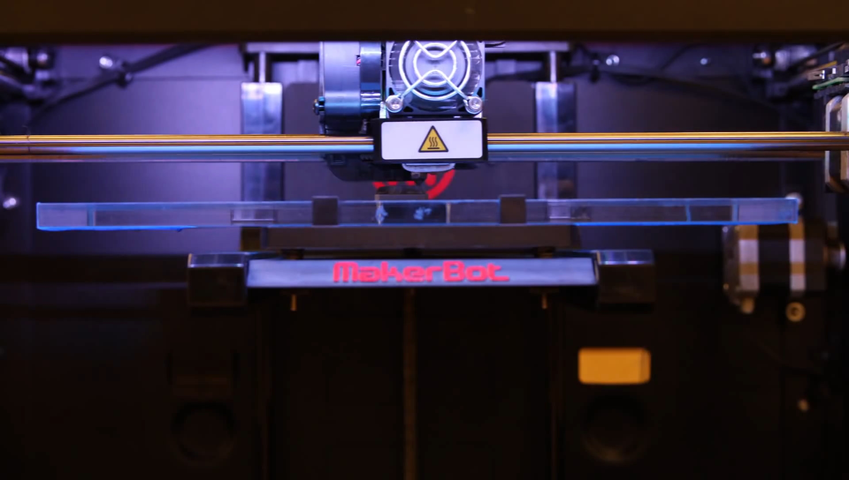
What is 3D Printing?
Video 1. FDM Printer [1]
Video 1. FDM Printer [1]

Slide 3
Problem Statements
Current hobbyist 3D printers are imprecise and fault-prone
High resolution additive manufacturing is currently not accessible for hobbyists

Slide 4
Our Solution
A DLP PAM system can produce higher quality and faster prints over current extruder based 3D printers
Use off-the-shelf open-source hardware to create an open-source DLP PAM system that is accessible to the hobbyist
Create a thoroughly documented reference design for the hobbyist community to build upon

Slide 5
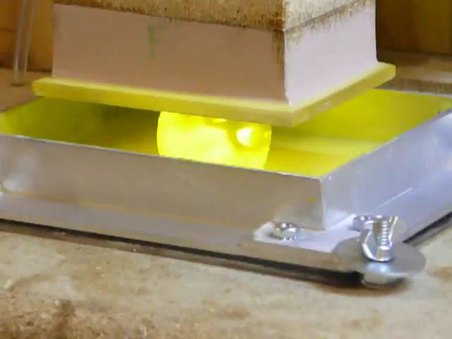
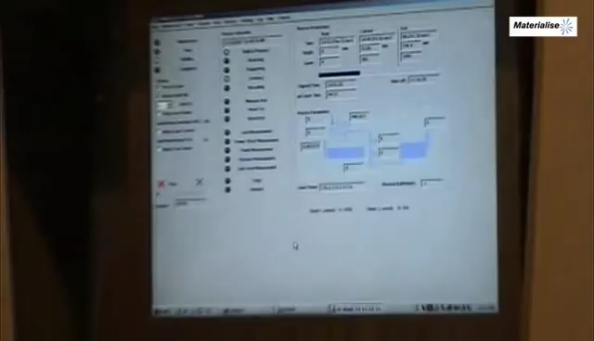
Photoresin Additive Manufacturing
Video 2. Commercial SLA Printer [2]
Video 3. Hobbyist DLP Printer [3]

Slide 6
Market Gap
Current photoresin additive manufacturing (PAM) systems have small build volumes
Available PAM systems use proprietary hardware and software

Slide 7
Criteria
Accessible to the hobbyist
Open Source and Free (as in speech)
Precise and repeatable
Able to enlarge print area or have larger print area from beginning

Slide 8
Subsystems
Print Control Software- Daniel Olsen
Motors/Motor Control- Casey Spencer
Mechanical Motion System/Chassis- Jeff Burdick
Resin Management and Optics- Chance Baker
Hardware Software Interface- Nick Lowman

Slide 9
Standards
ISO 262 - metric screw thread dimensions
DIN 103 - Trapezoidal lead screw dimensions
ANSI/NEMA MG 1-2011 - Stepper motor mounting dimensions
ISO 6983 - G-Code
ISO 10303-21 - STEP file
STL file format ( ungoverned )
ISO/ASTM 52915:2013 - Additive manufacturing file format
W3C XML 1.1 - Extensible Markup Language file format
ISO/IEC 14882:2011 / 2011 - C++ programming language

Slide 10
Print Control Software
Solution | B9 Creator | MiiCraft | Creation Workshop
Language | C++ | Python | C#
Cross-platform | ✓ | ✗ | ✓
Slicing Software | Custom | Skeinforge | Slic3r
G-Code Support | ✗ | ✓ | ✓
CAD File Input | STL | STL | STL, OBJ, 3DS
Able to Add Supports | ✓ | ✗ | ✓
Image Output | SLC | SVG | SVG
Table 1. Comparison chart of three open-source printer control software for DLP printer.

Slide 11
Functional Block Diagram

Slide 12
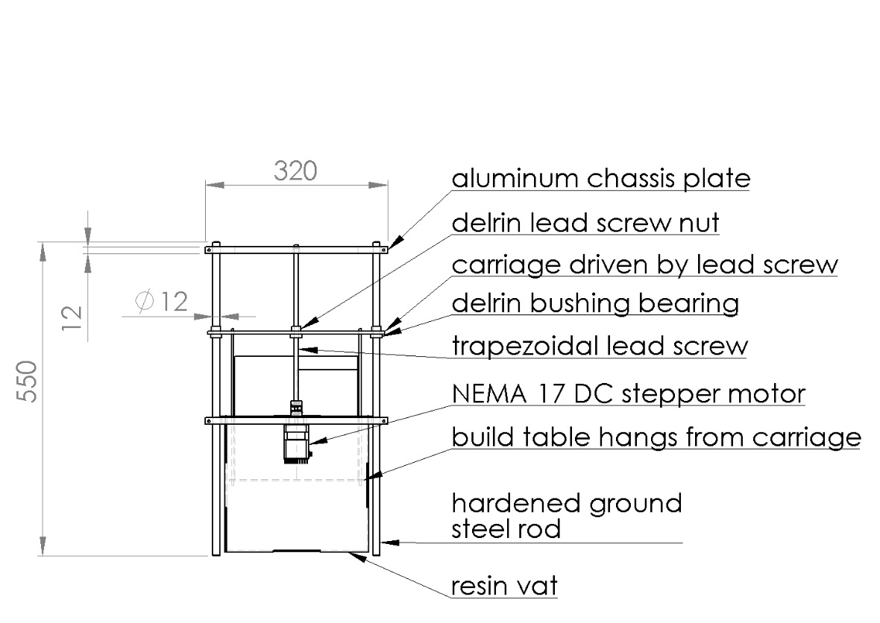
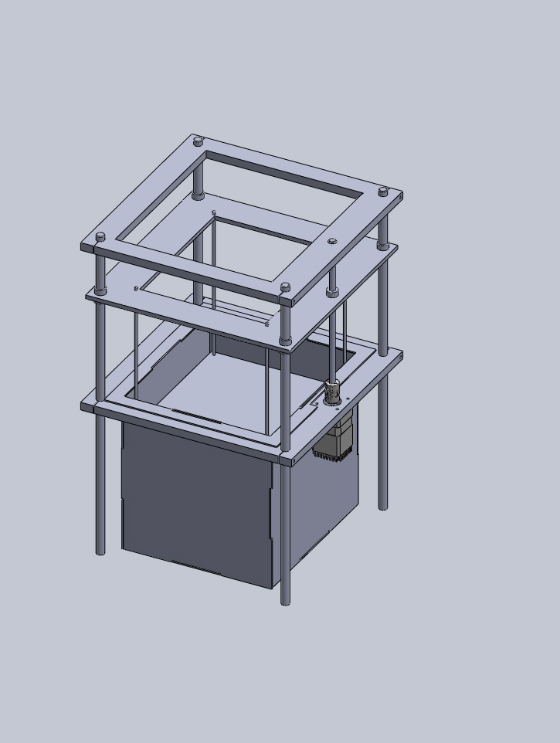
Chassis Design

Slide 13
Questions
Would the use of two lead screws be more appropriate?
What would be the most effective and elegant projector mounting system?
How to optics?

Slide 14
References
Materialise, "Mammoth Stereolithography Video from Materialise," 17 December 2008. [Online]. Available: https://www.youtube.com/watch?v=ky87zxNy1oo. [Accessed 14 April 2014].
C. B. Store, "3D Printer Time Lapse at the CU Book Store," 25 Febuary 2014. [Online]. Available: https://www.youtube.com/watch?v=wahE2unvnVk. [Accessed 14 April 2014].
B. Creations, "3D printed skull," 27 April 2012. [Online]. Available: http://youtu.be/J_82ET_otsQ. [Accessed 14 April 2014].

